Slide 1


HEGIFTOM: Timeline & Agenda
YEAR#01=2021 (M01-M12): Internal consistency within each network+ Preparation of Year#02
YEAR#02=2022 (M13-M24): Representativeness & External consistency among the networks through intercomparisons
YEAR#03=2023 (M25-M33): Exploitation of data sets (e.g. Trends) with other TOAR-II WG’s & Preparation of Publications
Kick Off Meeting Schedule:
Day#1 (22/03): Internal Consistency (Harmonization, Uncertainties: Random & Systematic), & Data Flagging (Year#01)
Day#2 (25/03): Representativeness in Time and Space: Collaborations with Satelites-, Numerical Models (Chemical Assimilation- or CTM-) FWG’s and SPARC-OCTAV/UTLS
Day#3 (29/03): External Consistency (Year#2) and Exploitation of Data (Year#03)
I
I
Phase
WG:
HEGIFTOM

Slide 2
TOAR-II Focus Working Group: HEGIFTOM (2021-2023/2024)
                Harmonization and
                Evaluation of
                Ground-based
                Instruments for
                Free
                Tropospheric Ozone
                Measurements
Phase II
https://igacproject.org/hegiftom-focus-working-group
WG:
HEGIFTOM
Kick-Off Meeting Day#2:
Introduction to “Representativeness” on Ground Based Observation Data
Relevant documents relevant for this meeting available at:
https://drive.google.com/drive/folders/1UfDkBevHgssWDt8-M2vg47HrBNE9tNN0
Notes:
For this

Slide 3
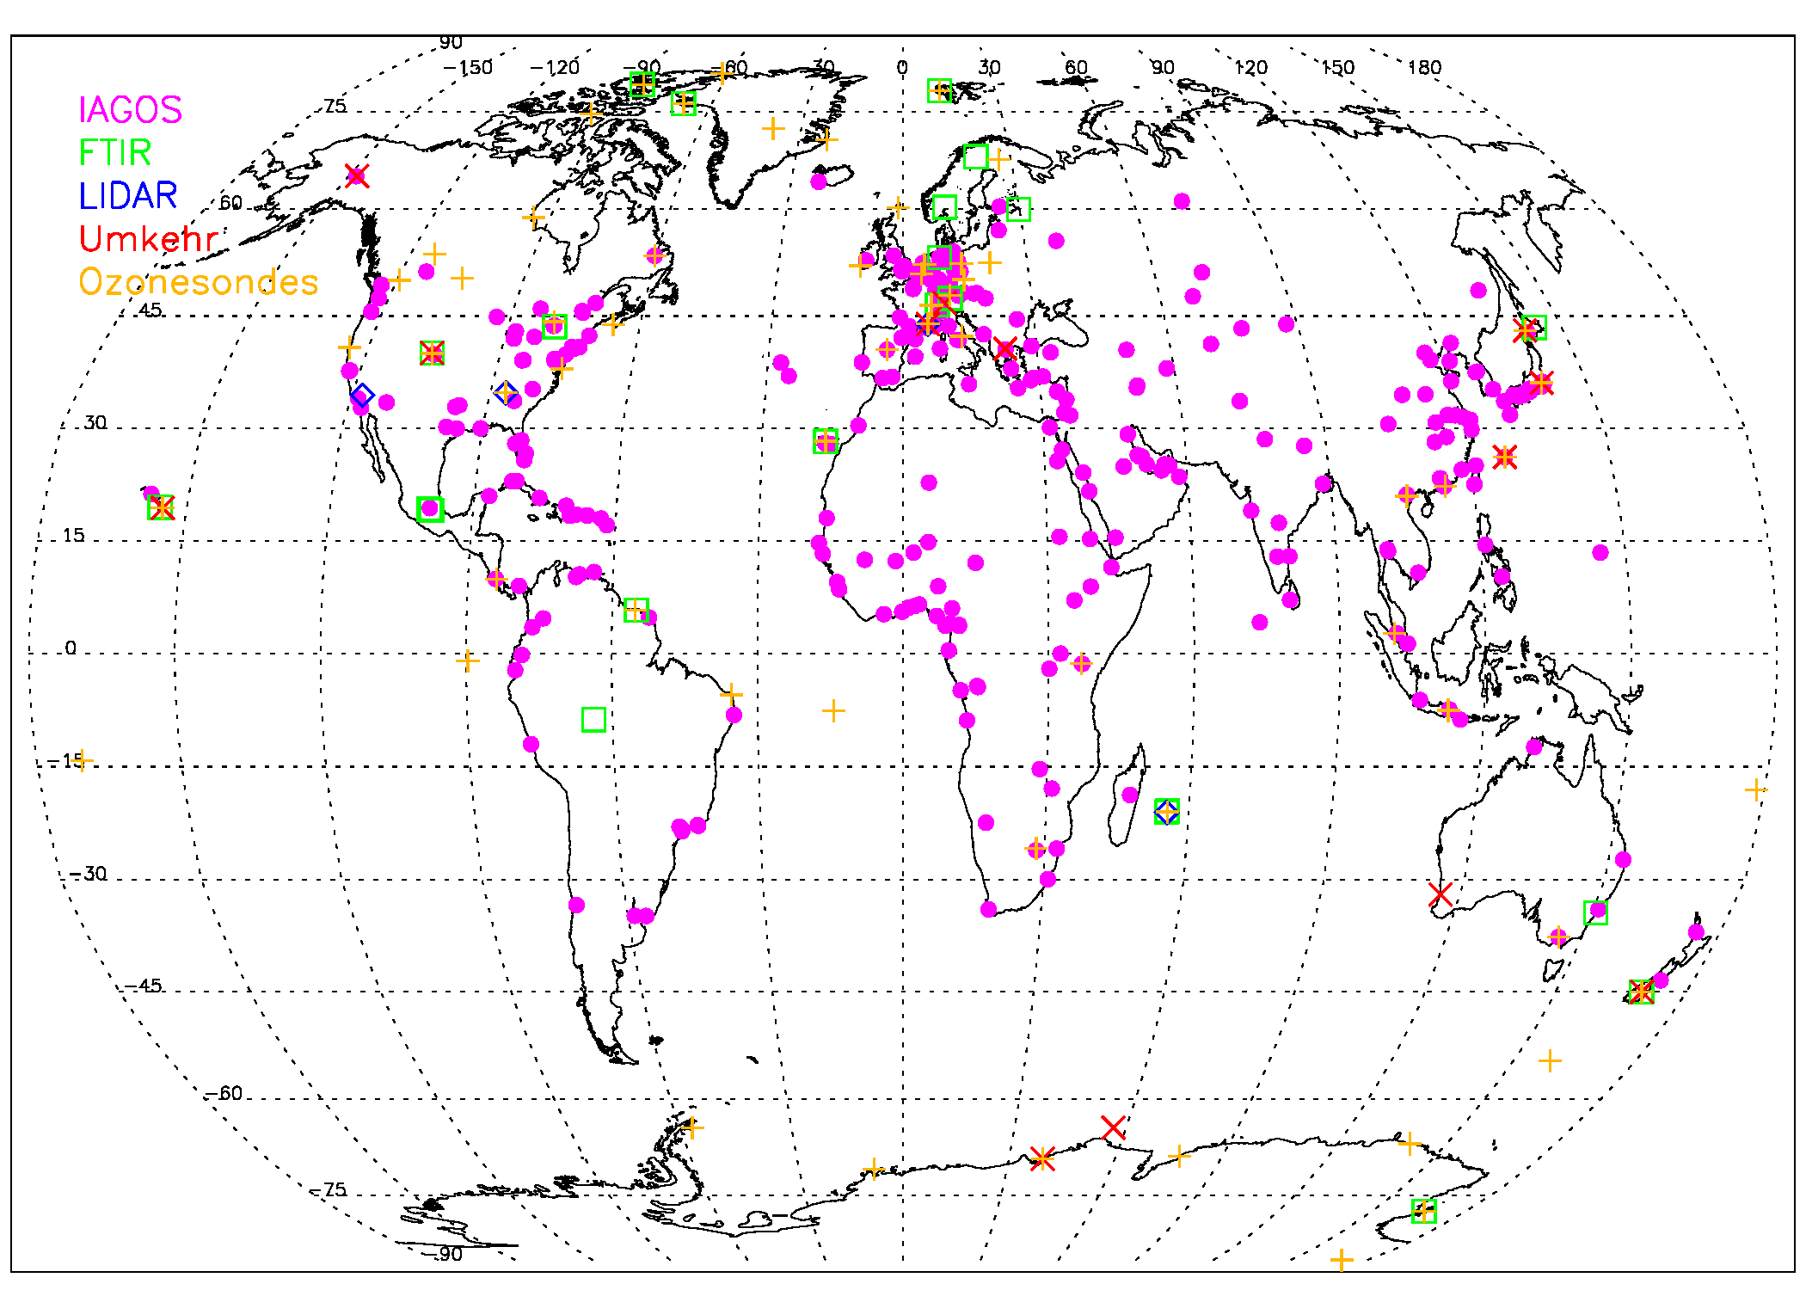
HEGIFTOM: External consistency
I
I
Phase
OHP
Boulder
Sapporo
Izana
WG:
HEGIFTOM
Mauna Loa
Reunion Is.
Lauder
“Supersites”

Slide 4
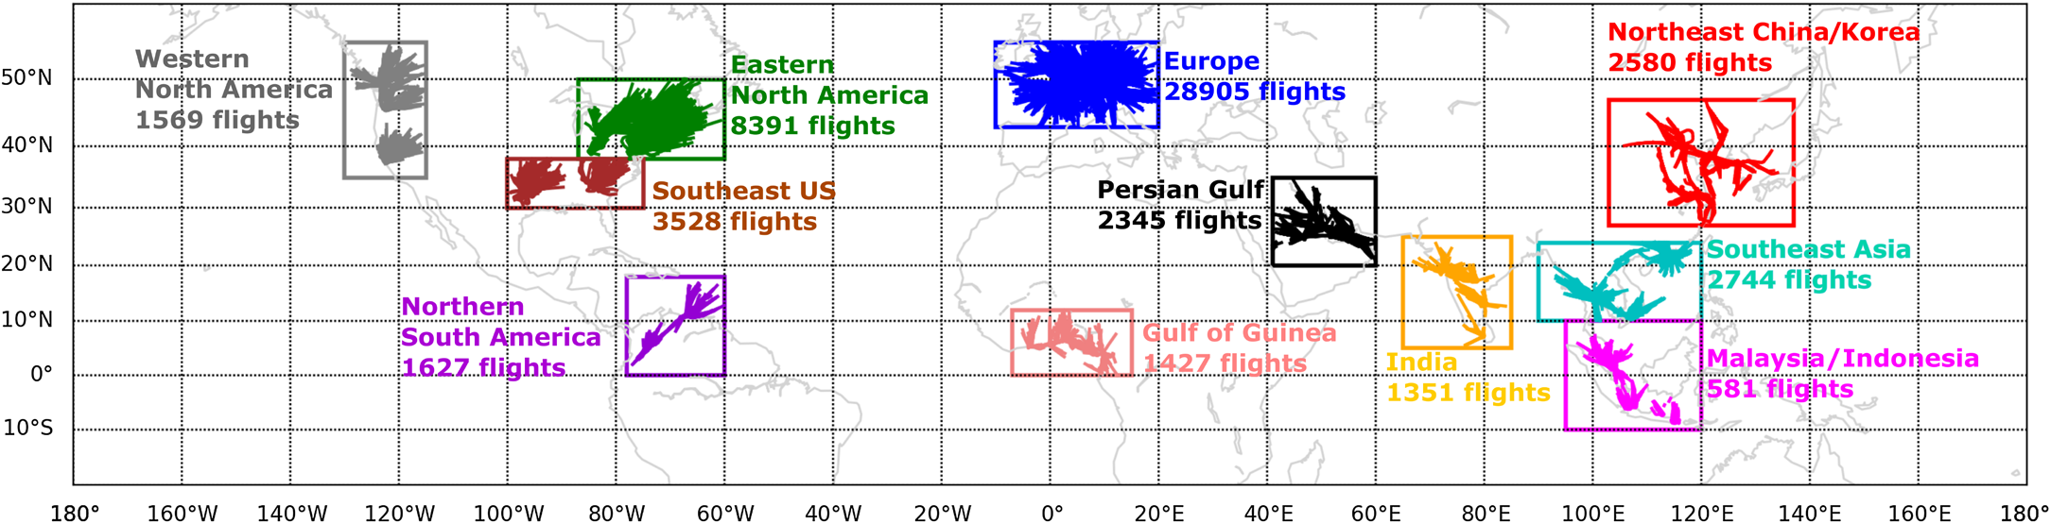
HEGIFTOM: Representativeness
Spatial (horizontal)
Regional characterization of tropospheric ozone field possible?
I
I
Phase
WG:
HEGIFTOM
Gaudel et al., Science Adv., 2020

Slide 5
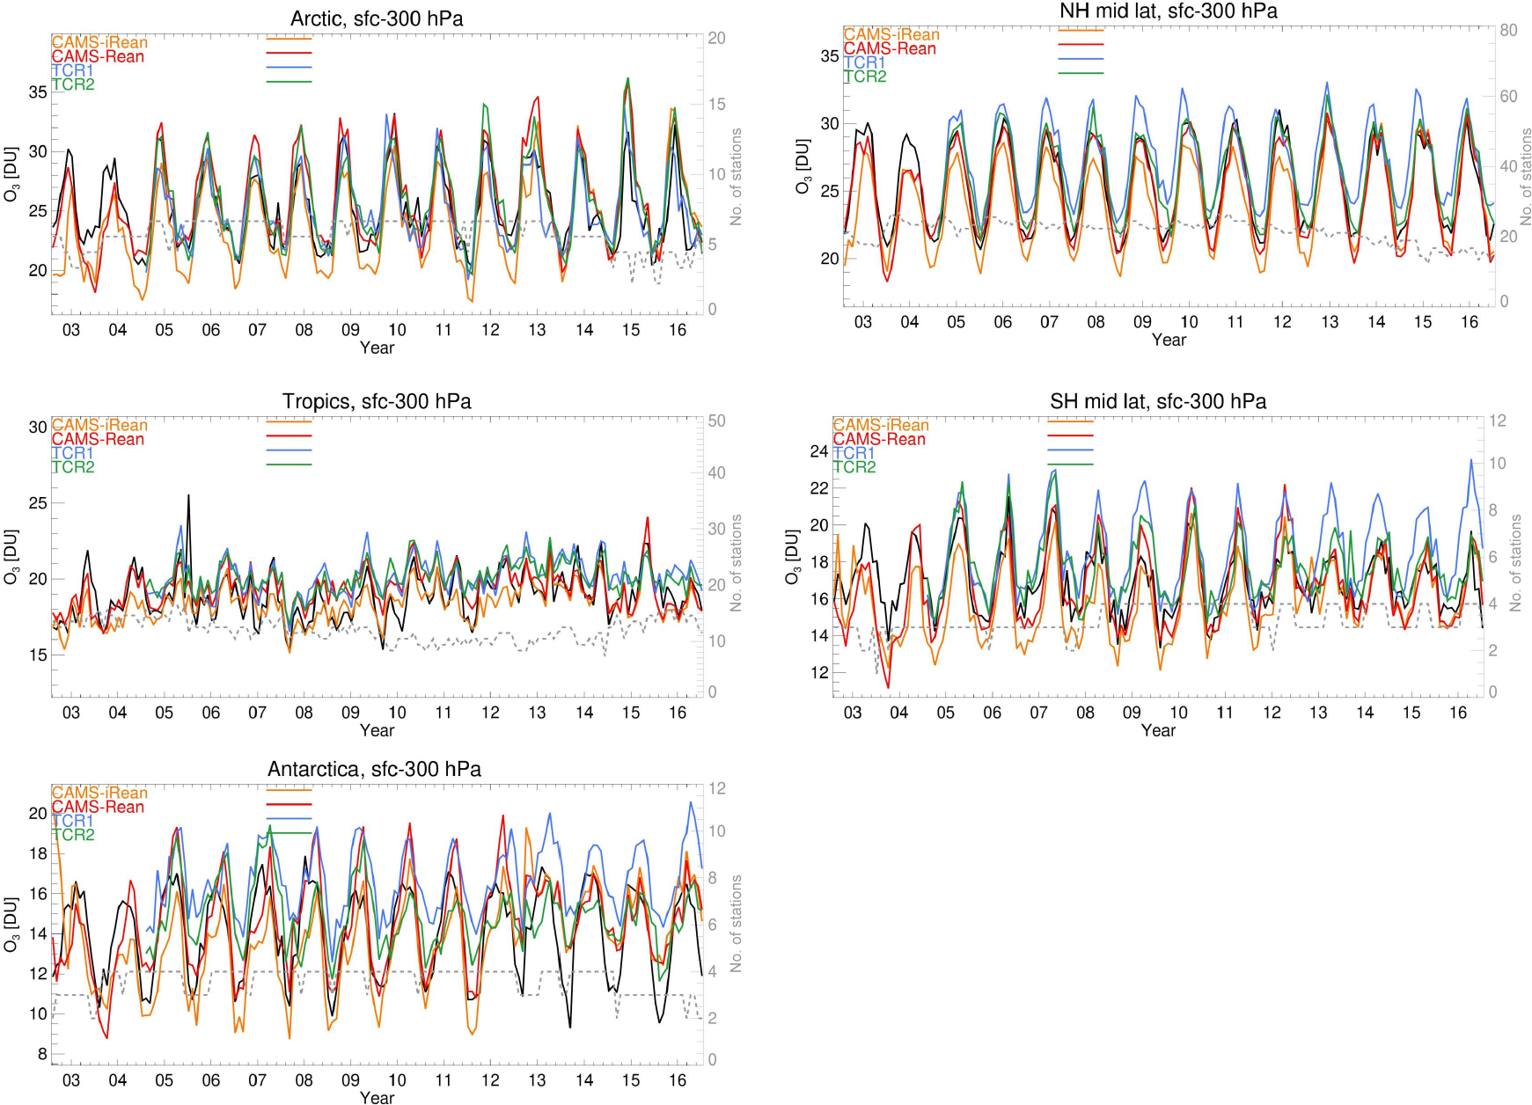
HEGIFTOM: Representativeness
Spatial (horizontal)
Regional characterization of tropospheric ozone field possible?
I
I
Phase
black:
ozonesonde observations
WG:
HEGIFTOM
Gaudel et al., Science Adv., 2020
Huijnen et al., Geosci. Model Dev., 2020

Slide 6
HEGIFTOM: Representativeness
Spatial (vertical)
Different averaging kernels
I
I
Phase
Dobson/Brewer Umkehr
FTIR
WG:
HEGIFTOM

Slide 7
HEGIFTOM: Representativeness
Spatial (vertical)
Different vertical resolutions
I
I
Phase
stratospheric!
WG:
HEGIFTOM
Hassler et al., AMT, 2014

Slide 8
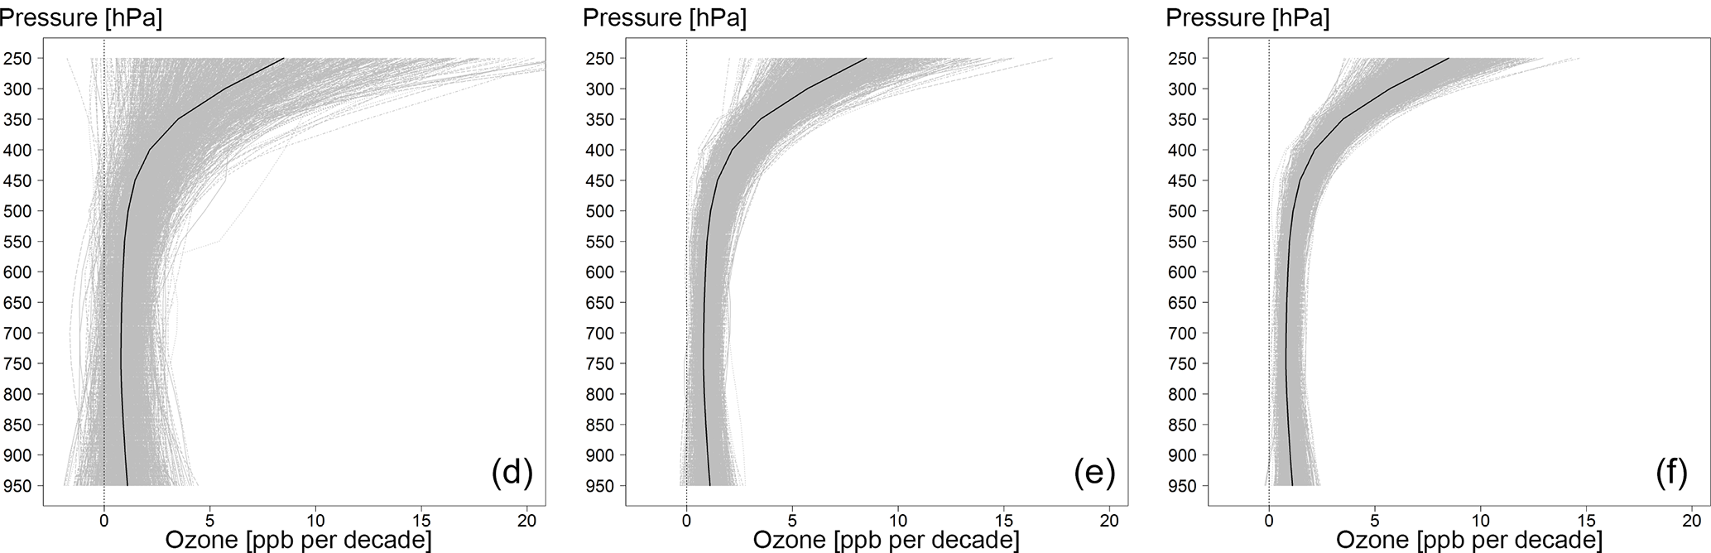
HEGIFTOM: Representativeness
Temporal
I
I
Phase
1 profile/month
5 profiles/month
9 profiles/month
WG:
HEGIFTOM
Sensitivity analysis for 1, 5, and 9 profiles per month based on 1000 random samples for each
of the 15 vertical levels above western Europe. Black curves: vertical distribution of the true trends based on IAGOS.
“an optimal sample frequency of 14 profiles per month is required to calculate trends with the integrated fit method (and about 18 profiles a month when this method is not used)”
Chang et al., ACP, 2020

Slide 9
HEGIFTOM: External Consistency
Consistency in the use of use of meteo data to convert instrument’s “natural” coordinates to common coordinates. How?
Common tropopause height definition! How?
Common boundary layer height
Common tropospheric ozone column extent vs. averaging kernels.
Vertical smoothing of ground-based measurements when compared to satellite retrievals.
Identical air masses (e.g. IAGOS vs. ozonesondes)?
I
I
Phase
WG:
HEGIFTOM

Slide 10
HEGIFTOM: Representativeness
Can we define/determine any metrics for “representativeness”?
How can we derive representativeness for a single station/an ensemble of stations (region)?
What are the typical “correlation” lengths (i.e times) of ozone at different altitudes (chemical and dynamical) in order to be able to separate between atmospheric and instrumental variability during intercomparisons.
How temporally representative are sites for estimating trends in tropospheric ozone?
Gridded satellite and model ozone datasets vs. ground-based measurements. How?
I
I
Phase
WG:
HEGIFTOM

