Slide 1


TOAR-II Focus Working Group: HEGIFTOM (2021-2023/2024)
                Harmonization and
                Evaluation of
                Ground-based
                Instruments for
                Free
                Tropospheric Ozone
                Measurements
Phase II
https://igacproject.org/hegiftom-focus-working-group
WG:
HEGIFTOM
Agenda Day#3:
External Consistency & Exploitation of Data
Exploitation of data (e.g. Trends) :Talk by Kai Lan Chang
Summary on Internal Consistency (incl. discussion)
Summary on External Consistency & Representativeness (incl. discussion)
Outlook & Final Discussion
Relevant documents relevant for this meeting available at:
https://drive.google.com/drive/folders/1UfDkBevHgssWDt8-M2vg47HrBNE9tNN0
Notes:
For this

Slide 2
Preamble to Day#3. of HEGIFTOM-KOM
Three important things to keep in mind:
HEGIFTOM is a challenging project, no doubt
But: HEGIFTOM is a bottom up activity, with NO extra Fundings
Thus: Let us start as simple as possible to get on the road and proceed only step by step into more complex approaches
I
I
Phase
WG:
HEGIFTOM

Slide 3
TOAR-II Focus Working Group: HEGIFTOM
Key Objective
Evaluation and harmonization of the different free tropospheric ozone datasets of the established measuring platforms.
Major Deliverable
Quality assessed ozone data sets, whereby each measurement gets also an uncertainty and a quality flag. Thereby , representativeness and instrumental drifts will be characterized and evaluated.
Workplan
Scheduled for three years: (i.) Internal consistency; (ii.) External consistency; (iii.) Exploitation of Data.
However, the time line given in the HEGIFTOM workplan is flexible and can be different for the different platforms (Responsibility of the Platform PI’s).
I
I
Phase
WG:
HEGIFTOM

Slide 4
I
I
Phase
Presentation by Kai-Lan Chang (mp4):
https://www.dropbox.com/s/801u38mfcs5tki5/HEGIFTOM_2021_klc.mp4?dl=0
WG:
HEGIFTOM

Slide 5
HEGIFTOM: Internal Consistency
Homogenization/harmonization activities within each network (incl. reporting of random or systematic uncertainties) is on the responsibility of the PI of each platform
No HEGIFTOM prescriptions, but comparing those activities enables the different platforms to learn from each other:
  Commonalities when meaningful for a platform
  Differences between platforms allowed
Primary deliverable to TOAR-II: internal consistent free- tropospheric ozone measurements for different ground-based platforms, in their natural coordinates plus the documentation of the the external consistency among the different platforms
I
I
Phase
WG:
HEGIFTOM

Slide 6
HEGIFTOM-KOM Day 1: Summary On Data Repository
Preamble
TOAR-II will not create a data base for free tropospheric observations or new data products. Only surface data of TOAR-I are in a common integrated data base (JOIN at FZJ: PI = Martin Schultz)
HEGIFTOM Policy on Data Storage:
HEGIFTOM will provide a password protected FTP-data server (limited capacity) to store processed data.
Original data primarily stored at the native data base of each measuring platform
HEGIFTOM will provide for each groundbased platform the entry point for the data base of the original data.
New, harmonised data can be stored on HEGIFTOM-ftp data server
Results from external consistency and eventual representativeness studies can be stored on HEGIFTOM-ftp data server or by another entry point if required
However, HEGIFTOM will be flexible and open for other practical solutions. BUT: keep things simple and manageable within the limited resources that are available
I
I
Phase
WG:
HEGIFTOM

Slide 7
Ground-based Free Tropospheric Ozone Measuring Platforms:
Homogenisation-Uncertainty (Random-Systematic)-Data Flagging-Internal Consistency
Instrument/ Platform | Homogeni-sation | Uncertainty: Random | Uncertainty: Systematic | Data Flagging | Internal Consistency
Ozone- sondes | Dec. 2021 | Yes | No | Yes | Dec.2021
MOZAIC/ IAGOS | Done | Yes | No | Yes | Yes (Blot et., AMT, 2020)
FTIR | Done (2021) | Per Station | Under Investigation | No | 2021
Lidar | Done (2021) | Yes | Yes | No | 2021
Umkehr (Dobson & Brewer) | 2021 | Under Investigation | Under Investigations | No | 2021
MAX-DOAS
Pandora
Phase-II
FWG:
HEGIFTOM
Development of a tropospheric data product
Development of a tropospheric data product
Data availability:
Individual platforms in their own data base(s)
Harmonised (gridded) data products to be determined

Slide 8
I
I
Phase
Discussion Internal Consistency:
Switch to HEGIFTOM-KOM Google Slides Day#3
WG:
HEGIFTOM

Slide 9
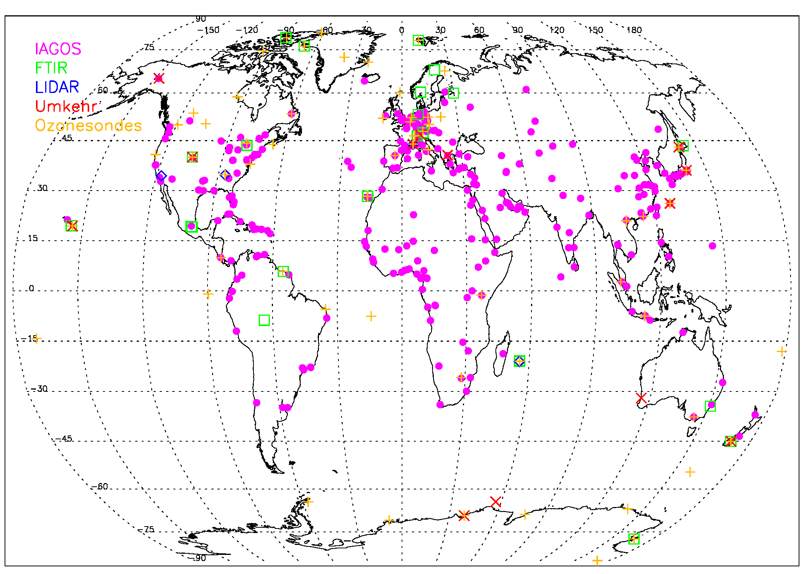
HEGIFTOM: External consistency
I
I
Phase
OHP
Boulder
Sapporo
Izana
WG:
HEGIFTOM
Mauna Loa
Reunion Is.
Lauder
“Supersites”

Slide 10
HEGIFTOM: External Consistency
Ground-based vs. ground-based at Supersites: assignments done for FTIR vs. Umkehr, FTIR vs. O3S, IAGOS vs. O3S
Provide table (matrix) with number of sites for each cross-comparison between ground-based techniques and assignments (Who is doing what)?
ground-based vs. ground-based or satellites:
  Obtain common O₃-quantities and vertical coordinates: need meteo data, for all in TOAR-II, from the same reanalysis model (e.g. ECMWF or MERRA-2 or ??) for providing temperature and density fields plus e.g. tropopause height (TPH), PBL-height: TOAR-II to decide which model should deliver these data
  Can OCTAV-UTLS deliver meteo data incl. TPH etc. (all based on MERRA-2)?
I
I
Phase
WG:
HEGIFTOM

Slide 11
Ground-based Free Tropospheric Ozone Measuring Platforms:
External Consistency
Instrument/ Platform | Ozone-sondes | MOZAIC/ IAGOS | FTIR | LIDAR | Umkehr (Dobson & Brewer)
Ozone- sondes |  | 23 sites + trajectories Blot, Smit, Van Malderen | 11 sites Vigouroux et al. | 3 sites | 9 sites
MOZAIC/ IAGOS |  |  | 7 sites | 2 sites | 9 sites
FTIR |  |  |  | 1 site | 5 sites Vigouroux & Irina
Lidar |  |  |  |  | 1 site
Umkehr (Dobson & Brewer)
MAX-DOAS
Pandora
Phase-II
FWG:
HEGIFTOM
Development of a tropospheric data product
Development of a tropospheric data product
Data availability:
Individual platforms in their own data base(s)
Harmonised (gridded) data products to be determined

Slide 12
Representativeness of Ozone Data in Time and Space:
Ozone Chemistry versus Transport
Very Slow (months): Quasi Steady State:
I
I
Phase
Stratosphere:
Global scale: slow ozone chemistry and vertical stability
WG:
HEGIFTOM
Slow (weeks)
Time Scale of Ozone Chemistry
Upper Troposphere/Lower Startosphere
Large scale: slow ozone chemistry
Lower/Middle Troposphere LT/MT:
Regional: Fast to slowert ozone chemistry
Near Surface (PBL):
Local: Fast ozone chemistry
Fast (hours)
Representativeness Ground Based O3 Observations:
Chemical Reanalysis or CTM‘s could help to deliver the typical time scales of ozone as a function of altitude, geographical location and time of the season!!!

Slide 13
HEGIFTOM: Representativeness
Ground-based sites need satellite/model output to study this!
Workplan of chemical reanalysis modelling group is covering this to large extent → collaboration!
How representative (vertical/horizontal/temporal) are the tropospheric ozone measurements we are performing at our site/in our network? → question of large interest to ground-based data provider at well!
Typical correlation lengths of tropospheric ozone? References?
Assignments?
I
I
Phase
WG:
HEGIFTOM

Slide 14
I
I
Phase
Discussion External Consistency and Representativeness:
Switch to HEGIFTOM-KOM Google Slides Day#3
WG:
HEGIFTOM

Slide 15
HEGIFTOM-Day#3: Outlook
A. Activities Identified on Internal and External Consistency & Exploitation of Data (Trends)
Intercomparisons at Supersites (2021/2022: Assignments: open → Table?)
HEGIFTOM-Intercomparisons of different platforms (2021/2022: Assignments: open)
  Table (next slide)
  IAGOS versus Ozonesondes (Blot/RVM&HS: 2021/2022)
  IAGOS versus Non-O3S (2021/2022: Possibility to be explored, Assignments: open)
  HEGIFTOM and Satellites (Collaboration with SO-FWG: Hubert/Keppens & Palmer)
HEGIFTOM and Chemical Reanalysis (Collaboration on Representiveness: Myazuki)
HEGIFTOM and Exploitation of data (e.g. Trends) ( in Collaboration on Statistics: Chang)
Laboratory: IAGOS versus UV-O3 Photometer (OPM) of WCCOS (2021): Traceability to common standard (Smit/Blot)
Next HEGIFTOM Meeting#2: Scheduled for September/October 2021
HEGIFTOM-Core Meetings on demand, Linkage with other TOAR-II FWG chairs
I
I
Phase
WG:
HEGIFTOM

Slide 16
Ground-based Free Tropospheric Ozone Measuring Platforms:
External Consistency
Instrument/ Platform | Ozone-sondes | MOZAIC/ IAGOS | FTIR | LIDAR | Umkehr (Dobson & Brewer)
Ozone- sondes |  | 23 sites + trajectories Blot, Smit, Van Malderen | 11 sites Vigouroux et al. | 3 sites | 9 sites
MOZAIC/ IAGOS |  |  | 7 sites | 2 sites | 9 sites
FTIR |  |  |  | 1 site | 5 sites Vigouroux & Irina
Lidar |  |  |  |  | 1 site
Umkehr (Dobson & Brewer)
MAX-DOAS
Pandora
Phase-II
FWG:
HEGIFTOM
Development of a tropospheric data product
Development of a tropospheric data product
Data availability:
Individual platforms in their own data base(s)
Harmonised (gridded) data products to be determined

Slide 17
Final Discussion: Anything left over?
I
I
Phase
Comments by Owen Cooper
WG:
HEGIFTOM

Slide 18
I
I
Phase
Thanks to All
For Your Contributions
and
Joining in this HEGIFTOM-KOM
And
Stay Healthy
WG:
HEGIFTOM

Slide 19
I
I
Phase
Reserve Slides
WG:
HEGIFTOM

Slide 20
I
I
Phase
WG:
HEGIFTOM

Slide 21
HEGIFTOM: Expected Outcomes
Homogenized time series of measured tropospheric ozone with uncertainty estimates and quality flags included.
Traceability to a common standard for the different ground-based networks
Characterization and eventual correction of instrumental drifts based on cross-comparisons between instruments at sites hosting different techniques or between instruments measuring identical air masses.
New explorative tropospheric ozone datasets from new UV-Vis instruments (Pandora & MAX-DOAS)
In collaboration with other TOAR-II focus working groups: assessment of the tropospheric ozone distribution and trends of tropospheric ozone.
I
I
Phase
WG:
HEGIFTOM

Slide 22
HEGIFTOM: Workplan + Timeline
YEAR#01=2021 (M01-M12):Internal consistency within each network+ Preparation of Year#02
March 2021: Kick-Off Meeting
Summer 2021: Inventory of operation procedures, practices, and data correction algorithms that are presently in use at the different sites/instruments within each network
Summer 2021: Concept (strategy) for cross intercomparison among different networks (incl. inventory of sites with co-located techniques and identification of identical air masses for in-situ measurements) >>>>> HEGIFTOM Meeting
Nov-Dec. 2021: harmonized and documented datasets as input of the cross-comparison between different ground-based techniques and focus working groups of satellites, models, statistics and other interests.
YEAR#02=2022 (M13-M24):External consistency among the networks through intercomparisons
cross intercomparison among different networks
characterization and evaluation of instrumental drifts among the different datasets.
Representativeness ground based observation platform-stations
YEAR#03=2023 (M25-M33): Exploitation of data sets with other TOAR-II WG’s & Preparation od publications
I
I
Phase
WG:
HEGIFTOM

Slide 23
HEGIFTOM: Ground-based Free Tropospheric Ozone Measuring Platforms
Instrument/Platform | Time period | Coverage/Network | Groups in HEGIFTOM
Ozonesondes | 1965 - present | > 50 Sites worldwide (GAW/WOUDC, NDACC, SHADOZ) | RMI (Belgium), FZJ (Germany), ECCC (Canada), NOAA (USA), NIWA (NZ), NASA (USA)
MOZAIC/IAGOS | 1994 - present | Cruise altitude (10-12 km) & Airports worldwide (100-250 Airports) | CNRS (France) & KIT (Germany
FTIR | 1995 - present | NDACC, 13-15 sites having more than 10 years of data | BIRA (Belgium), NCAR (USA), AEMET (Spain)
Lidar |  | NDACC, TOLNET (9-10 Sites) | NASA (USA), LATMOS (France), UAH (USA)
Umkehr (Dobson & Brewer) | 1956 - present | WOUDC (> Sites), NEUBrew, EUBrew (14 Sites) | NOAA (USA), MeteoSwiss (Switzerland), BoM (Australia), NIWA (New Zealand), OHP (France), AEMET (Spain), Univ. Thessaloniki (Greece)
MAX-DOAS | 2010-present | 5-10 Sites NDACC and associated sites | BIRA (Belgium)
Pandora | 2012 - present | > 40 sites at 2020, Pandonia Global Network (PGN) | NASA (USA), VTU (USA), LuftBlick (Austria)
Phase-II
FWG:
HEGIFTOM
Data availability:
Individual platforms in their own data base(s)
Harmonised (gridded) data products to be determined

Slide 24
Vertical Ozone Profiling Techniques at Z= 0-20 km
Established Techniques :
Ozonesondes: Electrochemical balloon borne sondes
Lidar: UV-DIAL = Differential Absorption Lidar in UV spectrum
FTIR: Fourier Transform Infra-Red of solar absorption spectrum
IAGOS (MOZAIC): UV-Photo-meter aboard In-Service Aircraft
Umkehr Retrievals: from Dobson & Brewer total O3 columns
New Techniques:
MAXDOAS: Multi Axis Differential Optical Absorption Spectroscopy
Satellites (e.g. TROPOMI, OMI, MLS etc.): remote sensing from space
I
I
Phase
WG:
HEGIFTOM

