Slide 1
HEGIFTOM Meeting
Lidar “Internal Consistency” Update
Thierry Leblanc
Jet Propulsion Laboratory, California Institute of Technology
Wrightwood, CA USA
© 2022 California Institute of Technology Government sponsorship acknowledged

Slide 2
What is HEGIFTOM’s “Internal Consistency” for Lidar?
It means “To create homogenized datasets out of the “normal” or “historical” datasets,
With as much standardization features and traceable information as possible”
Applicability:
TMF Tropospheric ozone lidar (TMTOL)
OHP tropospheric ozone lidar (OHP O3T)
Maybe… Reunion Island tropospheric ozone lidar (REU O3T)
Maybe… some more tropospheric ozone lidars (not “long-term”) (TOLNet)
Maybe… some stratospheric ozone lidars as well… (TMSOL, OHP O3S, HOHP, MLSOL)
Tools for homogenization:
GLASS Centralized Processing developed at JPL

Slide 3
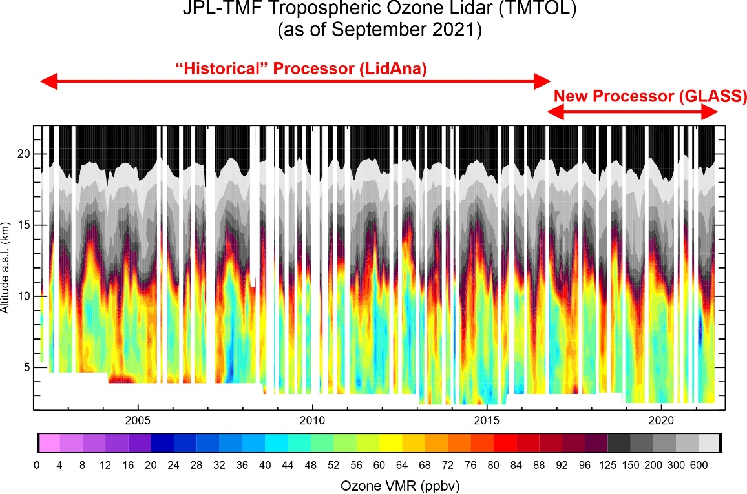
Homogenization Progress as of Sept 2021

Slide 4
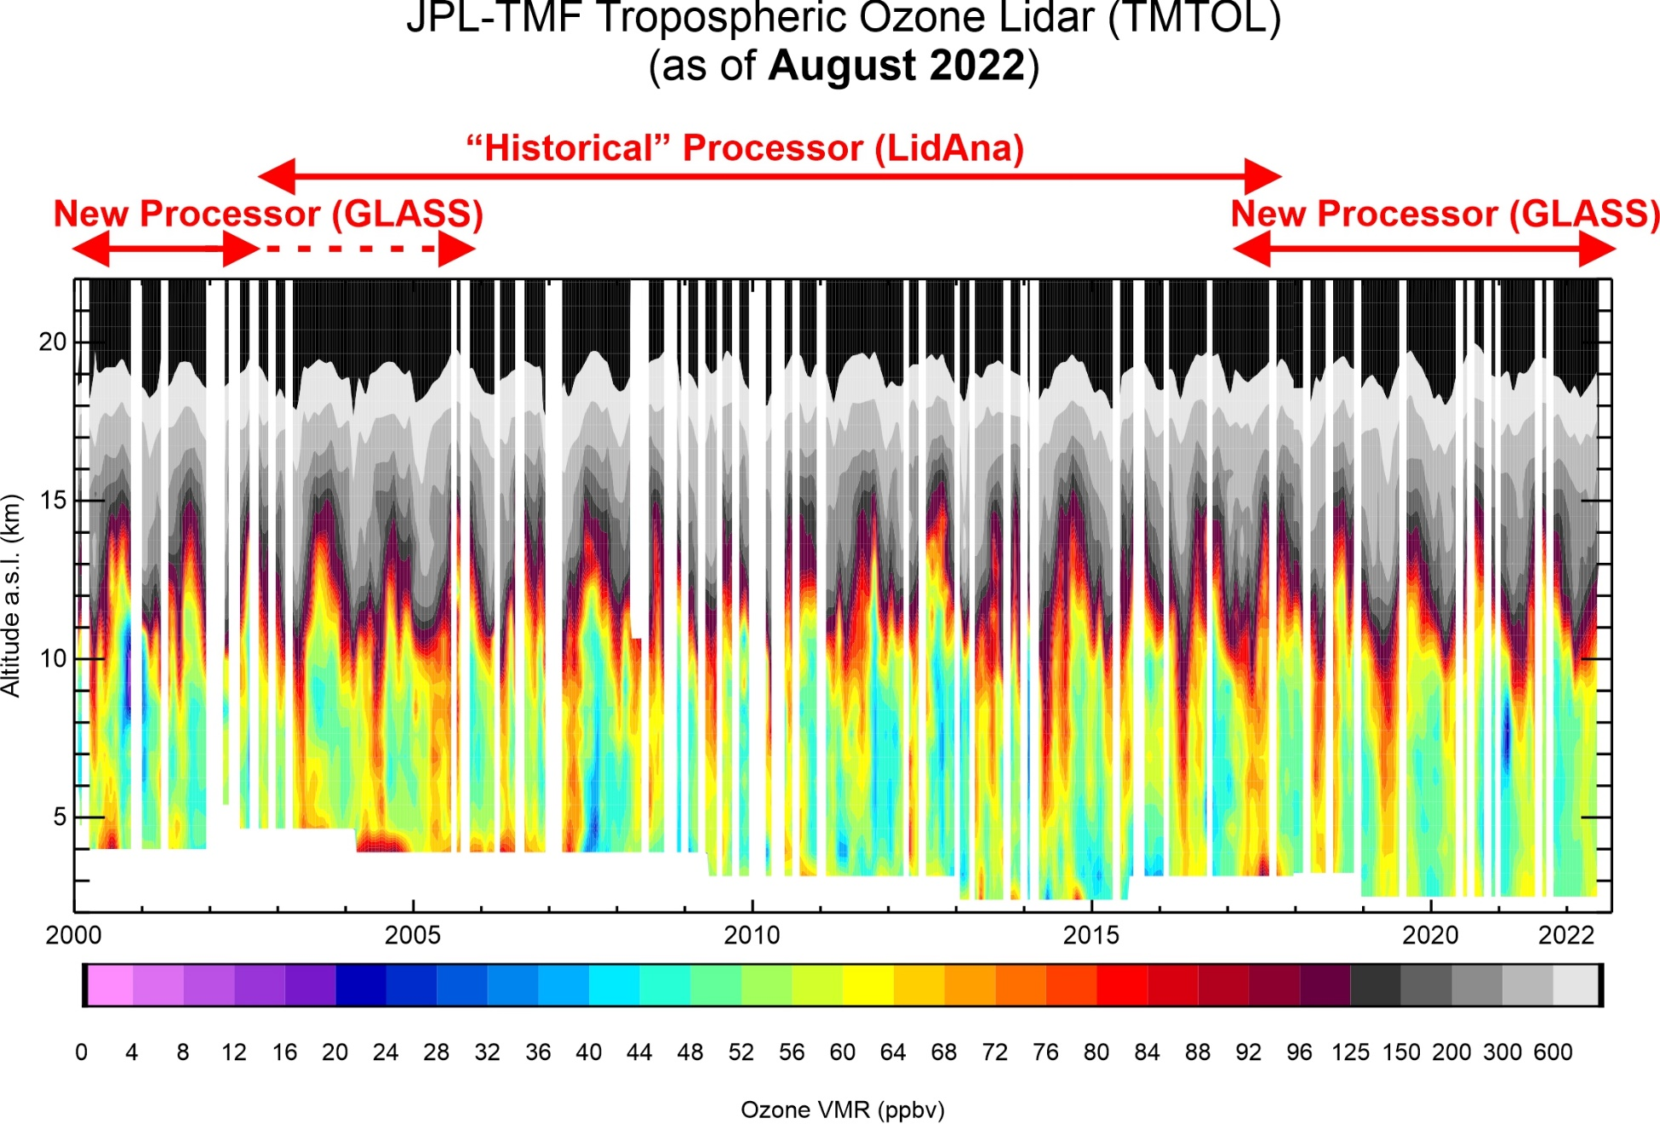
Homogenization Progress as of August 2022

Slide 5
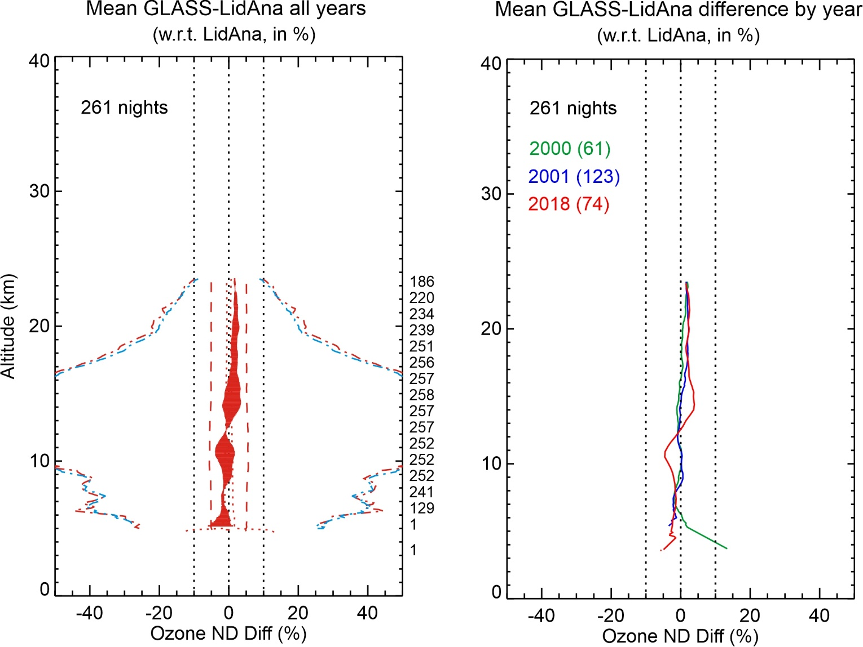
Difference GLASS (homogenized) vs. LidAna (historical) Processing
TMF Tropospheric Ozone Lidar (TMTOL)

Slide 6
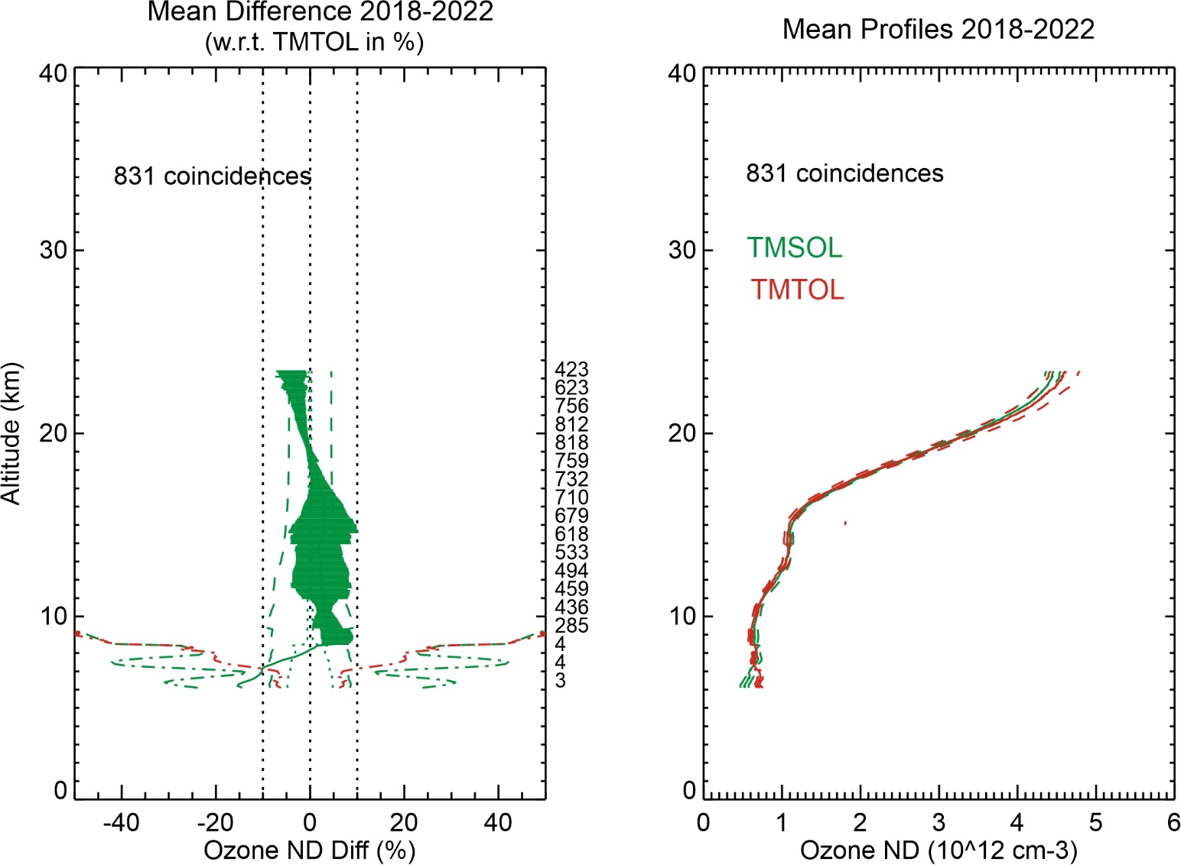
Difference TMF Tropospheric (TMTOL) vs. Stratospheric (TMSOL)
GLASS Processing, both instruments

Slide 7
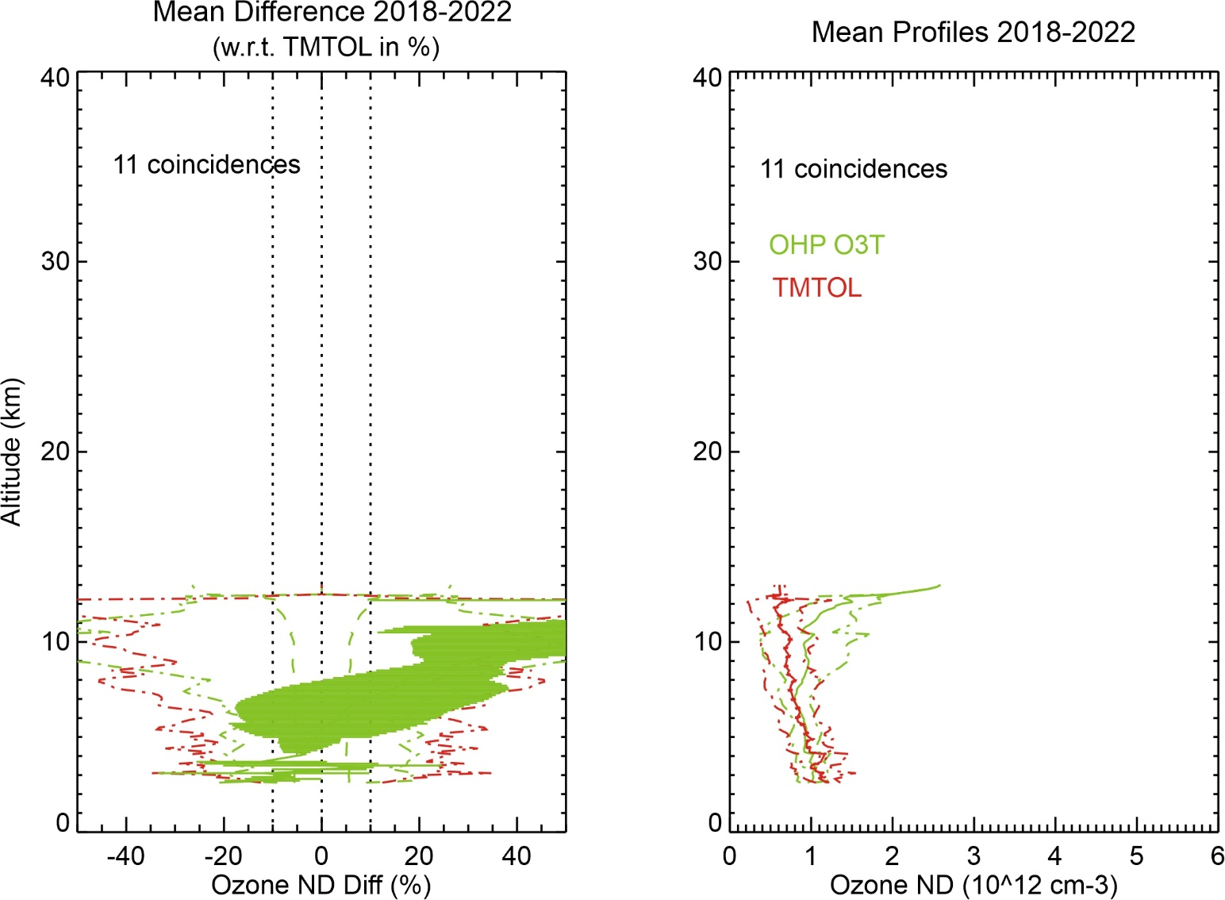
Difference TMF Tropospheric (TMTOL) vs. OHP Tropospheric (OHP O3T)
GLASS Processing for TMTOL, non-homogenized Processing for OHP O3T

Slide 8
Take-home message
GLASS (re-)Processing of TMF Tropospheric Ozone Lidar (TMTOL) is still ongoing:
Slow process due to (many) various reasons…
Years 2018-present available and accessible at NDACC + TOLNet
Years 2000-2005 are available but not yet shared at NDACC
Years 2006-2012 will be available within 2 months
Years 2013-2017 should be available by early 2023 (possibly earlier…)
Full homogenized dataset (2000-2017) will be released to complement 2018-present period when all years are re-processed; Until then, use “Historical” dataset for pre-2018
GLASS Processing of OHP Tropospheric Ozone Lidar (OHP-O3T) is still pending:
Started exchanges with PI Gerard Ancellet
Raw data not yet available, but will be available second week of September
Thierry will meet Gerard at 2022 NDACC Steering Committee Meeting in Paris in September
Hoping for an homogenized version (2012-present) in early 2023

